Slide 1
18CSC304J COMPILER DESIGN
UNIT 5
SESSION 13

Slide 2
Topics that will be covered
Activation Records
Storage Allocation Strategies

Slide 3
ACTIVATION RECORDS (Already covered in last session)

Slide 4
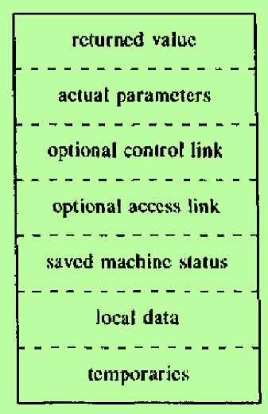
Activation Records
Information needed by a single execution of a procedure is managed using a contiguous block of storage called an activation record or frame, consisting of the collection of fields as shown in the figure
The sizes of each of these fields can be determined at the time a procedure is called
In fact, the sizes of almost all fields can be determined at compile time, except if a procedure has a local array whose size is determined by the value of an actual parameter, available only when the procedure is called at run time
When a procedure is called, its activation record is pushed onto the run-time stack and when control returns to the caller, the activation record is popped off the stack

Slide 5
Purpose of the fields in an Activation Record
Temporaries : Stores the temporary values arising in the evaluation of expressions
Local Data : Holds data that is local to an execution of a procedure
Saved Machine Status : Holds information about the state of the machine just before the procedure is called
Optional Access Link : Refers to non-local data held in other activation records
Optional Control Link : Points to the activation record of the caller
Actual Parameter : Used by the calling procedure to supply parameters to the called procedure
Returned Value : It is used by the called procedure to return a value to the calling procedure

Slide 6
STORAGE ALLOCATION STRATEGIES

Slide 7
Storage Allocation Strategies
There are three different storage-allocation strategies:
Static Allocation
Stack Allocation
Heap Allocation
Static allocation lays out storage for all data objects at compile time
Stack allocation manages the run-time storage as a stack
Heap allocation allocates and deallocates storage as needed at run time from a data area known as a heap

Slide 8
1. Static Allocation
In static allocation, names are bound to storage as the program is compiled
So, there is no need for run-time support package
Every time a procedure is activated, its names are bound to the same storage locations
This property allows the values of local names to be retained across activations of a procedure
From the type of a name, the compiler determines the amount of storage to set aside for that name
The address of this storage consists of an offset from an end of the activation record for the procedure
The compiler must decide where the activation records go, relative to the target code and to one another
Once this decision is made the position of each activation record and hence the storage for each name in the record is fixed
At compile time we can fill in the addresses at which the target code can find the data it operates on
Similarly, the addresses at which information is to be saved when a procedure call occurs are also known at compile time

Slide 9
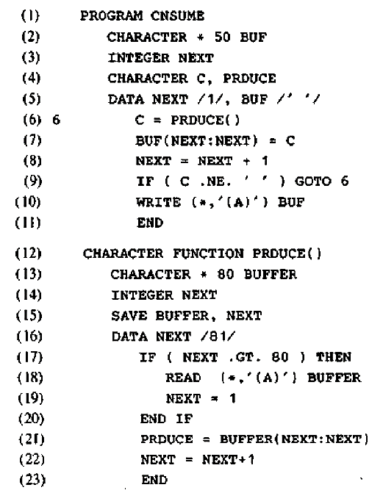
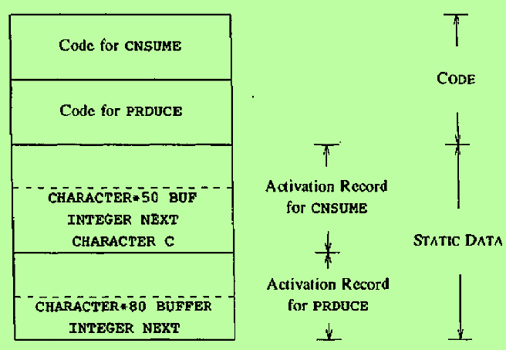
1. Static Allocation – Example

Slide 10
1. Static Allocation – cont..
Limitations of Static Allocation
The size of a data object and constraints on its position in memory must be known at compile time
Recursive procedures are restricted, because all activations of a procedure use the same bindings for local names
Data structures cannot be created dynamically, since there is no mechanism for storage allocation at run time

Slide 11
2. Stack Allocation
Stack allocation is based on the idea of a control stack
Storage is organized as a stack, and activation records are pushed and popped as activations begin and end respectively
Storage for the locals in each call of a procedure is contained in the activation record for that call
Thus locals are bound to fresh storage in each activation, because a new activation record is pushed onto the stack when a call is made
The values of locals are deleted when the activation ends, because the storage for locals disappears when the activation is popped
Suppose that register top marks the top of the stack
At runtime an activation record can be pushed and popped by incrementing and decrementing top by the size of the record

Slide 12
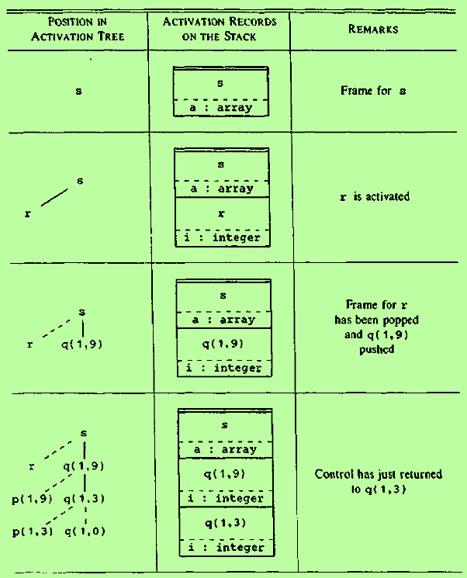
2. Stack Allocation – Example
The figure shows the activation records that are pushed onto and popped from the run-time stack as control flows through the activation of tree
Dashed lines in the tree represent activations that have ended
When control reaches the first call in the body of s, procedure r is activated and its activation record is pushed onto the stack
When control returns from this activation, the record is popped leaving just the record for s in the stack
In the activation of s, control then reaches a call of q with actuals 1 and 9, and an activation record is allocated on top of the stack for an activation of q
Whenever control is in an activation, its activation record is at the top of the stack

Slide 13
2. Stack Allocation – cont..
Calling Sequences
Procedure calls are implemented by generating calling sequences in the target code
A call sequence allocates an activation record and enters information into its fields
A return sequence restores the state of the machine so that the calling procedure can continue exec
Principle that aids the design of Calling Sequences and Activation Records
Fields whose sizes are fixed early are placed in the middle of the activation records (eg) control link, access link and machine status field appear in the middle
Size of the filed for temporaries may not be known to the front end, because the number of temporaries needed may be reduced during optimization stage. So the field for temporaries is placed after that for local data, so that its size will not affect other fields
Usually, the fields for parameters and return value is placed in the beginning of the activation record of the callee

Slide 14
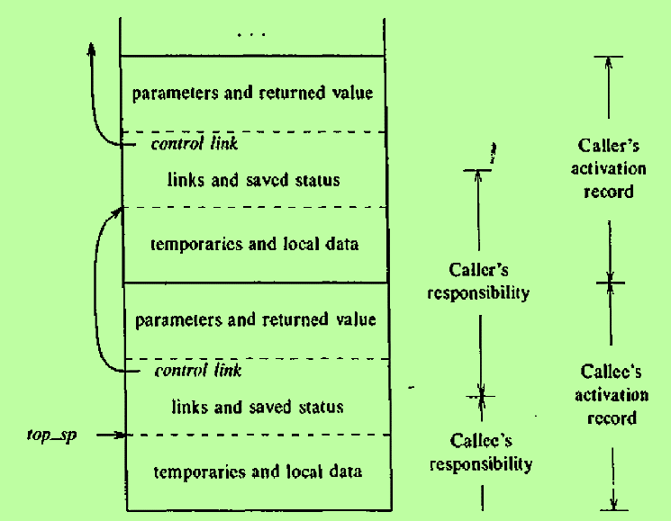
2. Stack Allocation – cont..
Division of tasks between caller and callee
The code in the calling sequence is divided between the calling procedure (caller) and the procedure calls (callee)
The register top_sp points to the end of the machine-status field in an activation record
This position is known to the caller
So the caller is responsible for setting top_sp before control flows to the called procedure
The callee can access its temporaries and local data using offsets from top_sp

Slide 15
2. Stack Allocation – cont..
Call Sequences
The caller evaluates actuals
The caller stores a return address and the old value of top_sp into the callee’s activation record. The caller then increments top_sp, that is top_sp is moved past the caller’s local data and temporaries and the callee’s parameter and status fields
The callee saves register values and other status information
The callee initializes its local data and begins execution
Return Sequence
The callee places a return value next to the activation record of the caller
Using the information in the status field, the callee restores top_sp and other registers and branches to a return address in the caller’s code
Although top_sp has been decremented, the caller can copy the return value into its own activation record and use it to evaluate an expression

Slide 16
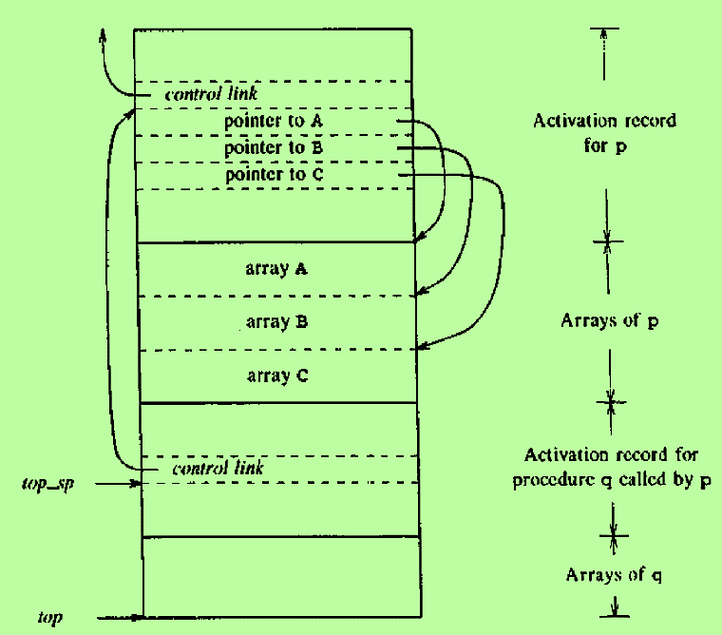
2. Stack Allocation – cont..
Variable Length Data
A common strategy for handling variable-length data is suggested in the figure
The procedure p has 3 local arrays
The storage for these arrays is not part of the activation record
Only a pointer to the beginning of each array appears in the activation record
Access to data on the stack is through two pointers : top and top_sp
top marks the actual top of the stack. It points to the position at which the next activation record will begin
top points to the position at which the next activation record will begin. top_sp is used to find local data

Slide 17
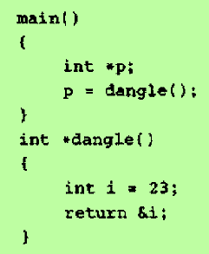
2. Stack Allocation – cont..
Dangling References
A dangling reference occurs when there is a reference to storage that has been deallocated
It is a logical error to use dangling references, since the value of deallocated storage is undefined according to the semantics of most languages
In the example, procedure dangle in the C program returns a pointer to the storage bound to the local name i
The pointer is created by the operator & applied to i
When control returns to main from dangle, the storage for locals is freed and can be used for other purposes
Since p in main refers to this storage, the use of p is a dangling reference

Slide 18
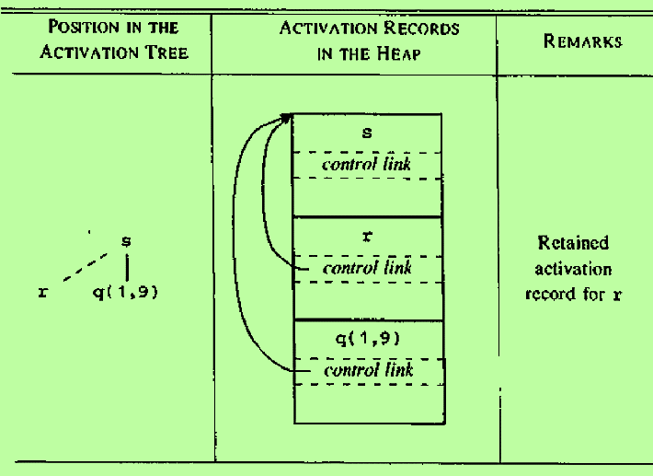
3. Heap Allocation
When Stack allocation cannot be used?
When the values of local names must be retained when an activation ends
A called activation outlives the caller. This possibility cannot occur for those languages where activation trees correctly depict the flow of control between procedures
Heap Allocation
Heap allocation parcels out pieces of contiguous storage, as needed for activation records or other objects
Pieces may be allocated in any order, so over time the heap will consist of alternate areas that are free and in use

Slide 19
3. Heap Allocation – cont..
The activation record for r is retained even after the activation ends
When the activation record for r is deallocated, there will be free space in the heap between the activation records for s and q(1,9)
It is left to the heap manager to make use of this space

Slide 20
3. Heap Allocation – cont..
Handling Activation records using Heap
There is generally some time and space overhead associated with using a heap manager
For efficiency reasons, we can handle small activation records as follows:
For each size of interest, keep a linked list of free blocks of that size
If possible, fill a request for size s with a block of size s’, where s’ is the smallest size greater than or equal to s. When the block is deallocated, it is returned to the linked list it came from
For large blocks of storage use the heap manager
This approach results in fast allocation and deallocation of small amounts of storage, since taking and returning a block from a linked list are efficient operations

